Slide 1
RUNNING APPLICATIONS USING DOCKER CONTAINER ON HDP-3.1
Presenter : Tejhan Bharadwaj Ramkumar, University of Maryland Baltimore County
MS in Computer Science
Mentor: Todd Larchuk
Coordinator: Steve Polston

Slide 2
A Few Important terms to know:
Apache Hadoop is an big-data open-source framework for distributing large data sets across clusters of computer using simple programming models.
Hortonworks Data Platform (HDP) is a commercial Hadoop product provided by a company called Hortonworks
Hadoop (named after Doug Cutting’s son’s toy elephant)
Hadoop Distributed File System (HDFS) a distributed file system designed to run on commodity hardware.
Yet Another Resource Negotiator (YARN) a resource manager and job scheduler.
YARN managers containers using Linux Containers (LXC), which is an operating-system-level virtualization method for running multiple isolated Linux systems (containers) on a host using a single Linux kernel.

Slide 3

What is Docker?
A software tool for creating and running isolated containers on a single host using LXC.
Incorporates methods for storing and retrieving images from a repository, like Docker Hub.
Helps a developer package up an application with all of the parts it needs and ship it all out as one package.

Slide 4
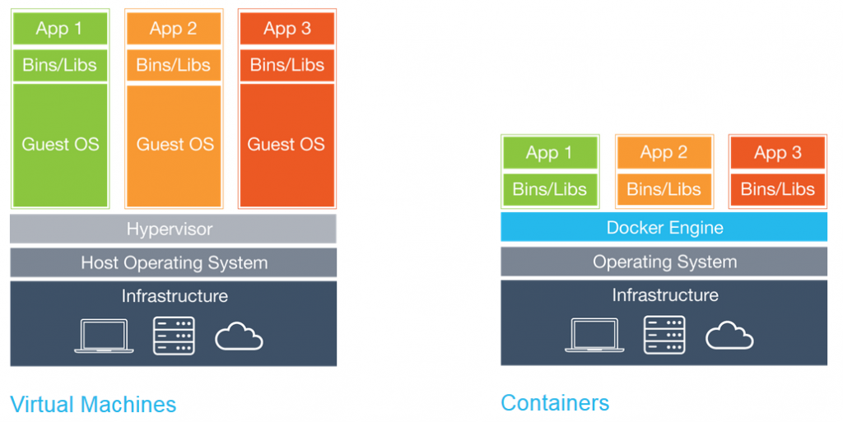
YARN Containers vs Docker Containers.
Programs in YARN containers are isolated from each other but use both the operating-system kernel programs and the application software that is already installed on the host.
Programs in Docker containers use the same operating-system kernel functions as YARN containers but are isolated from the applications installed on the host and have access only to what the user has installed in the Docker container.
This means that by using a Docker container the user can create their own environment, including version of applications that are not available or different from what is already installed on the host.

Slide 5

Objective
Install a Hadoop 3 cluster
Install Docker on all the working nodes of the cluster.
Configure the cluster in such a way that it support both YARN containers and Docker containers.
Demonstrate that it works.

Slide 6
Why are we doing this? (Hadoop 3 supports Docker containers)
Docker containers are becoming the leading container technology.
Deploying Docker containers with YARN allows application to have their own custom environment and versions of software, HBASE, SPARK, R, etc. that are different from what the administrator of the cluster might have installed.
ACUMOS can deploy machine-learning models as Docker containers but current does not have any mechanism to deploy into a Hadoop cluster.

Slide 7
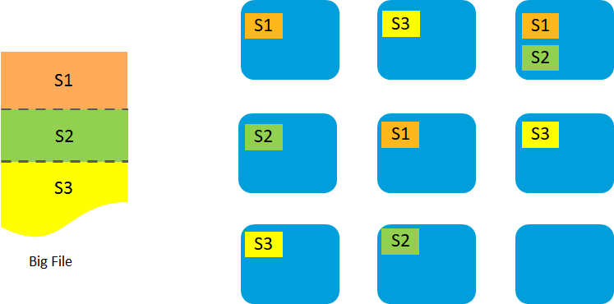
HADOOP DISTRIBUTED FILE SYSTEM (HDFS)
This is our storage system.
Splits big files into blocks and stores them on different hosts.
Replicates each for resiliency, typically 3 copies of every block.

Slide 8
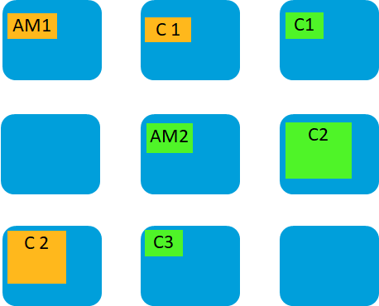
YET ANOTHER RESOURCE NEGOTIATOR (YARN)
It is the framework for running applications and it manages CPU, resources and memory.
YARN creates containers in which applications run.
Every Yarn application has a container running an application master. The application master can request other containers for the application to run in.

Slide 9
Running a ML model using Docker Containers on YARN
Training Data runs in Docker-1.
Builds the model. Stores it in HDFS.
Testing Data runs in Docker-2.
Does Prediction. Stores output in HDFS
Train
Predict
HDFS
Train Data
Test Data
Model
Prediction

Slide 10
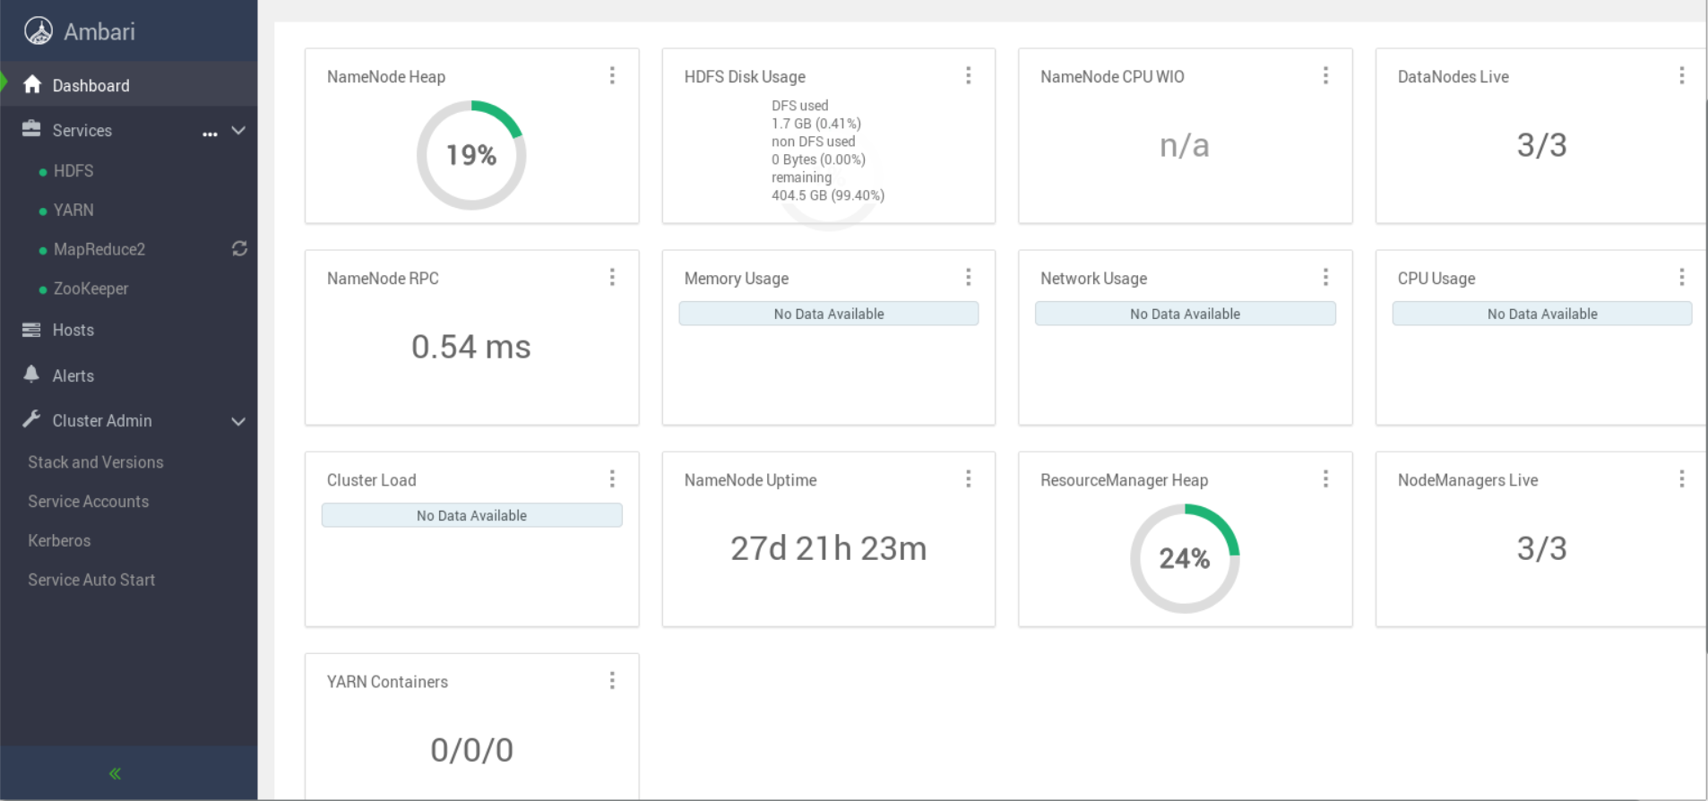
Real-time view of the cluster
Apache Ambari provides easy-to-use Hadoop management Web UI that helps us in managing and monitoring and configuring the Hadoop cluster.
Once the cluster is setup with necessary services you can manage and monitor the cluster from the dashboard.

Slide 11
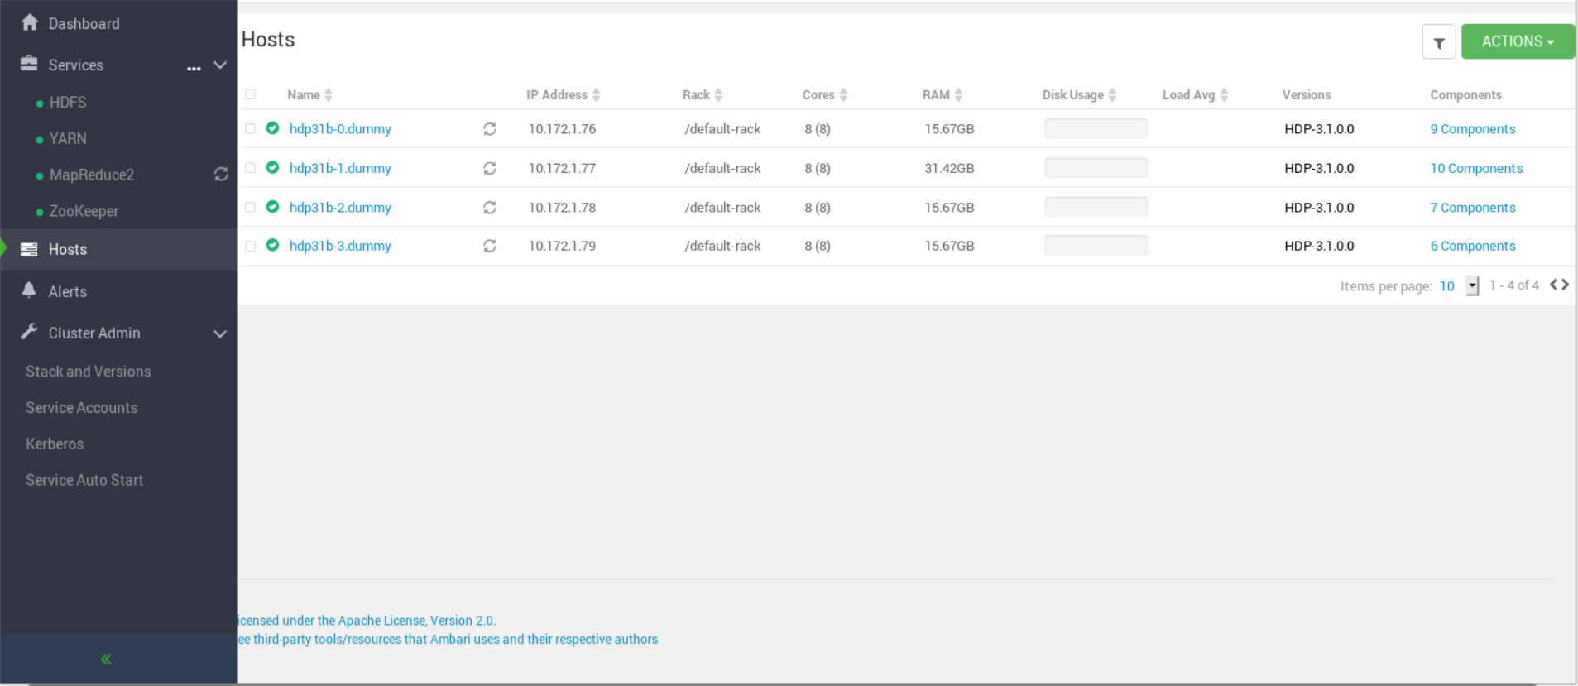
Real-time view of the cluster (Cont.)
Overview of each host in the cluster and what components are present in each host.

Slide 12
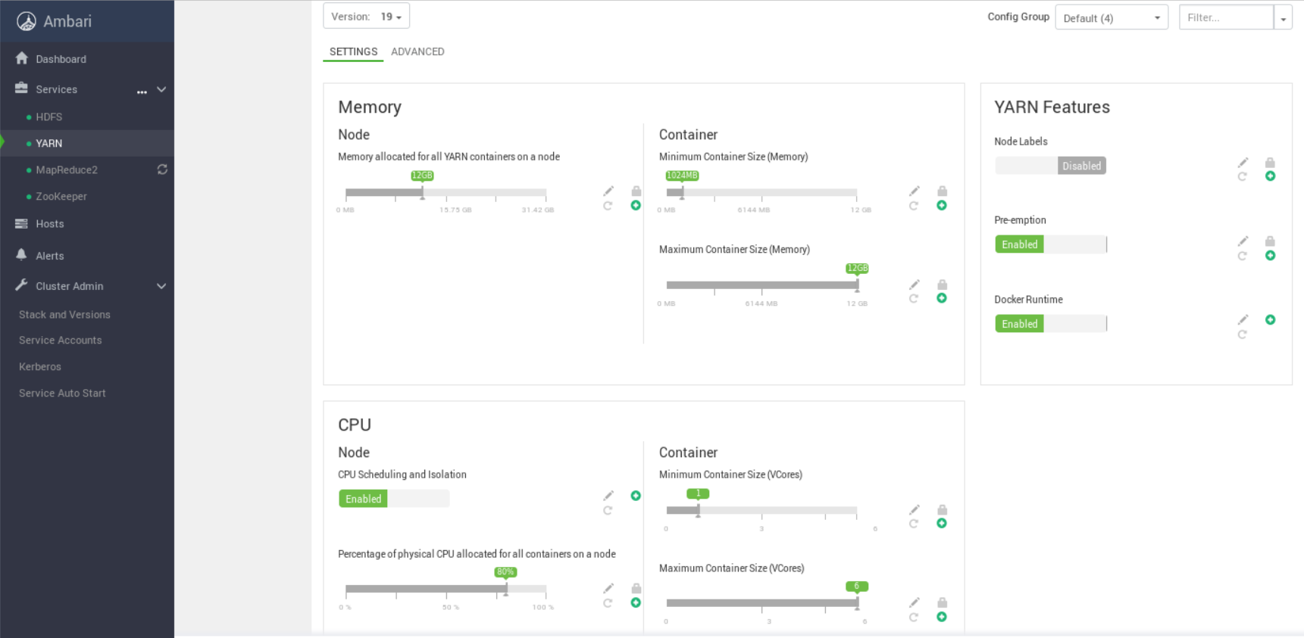
Real-time view of the cluster (Cont.)
You can configure HDFS and YARN settings according to what you want to perform with your cluster.

Slide 13
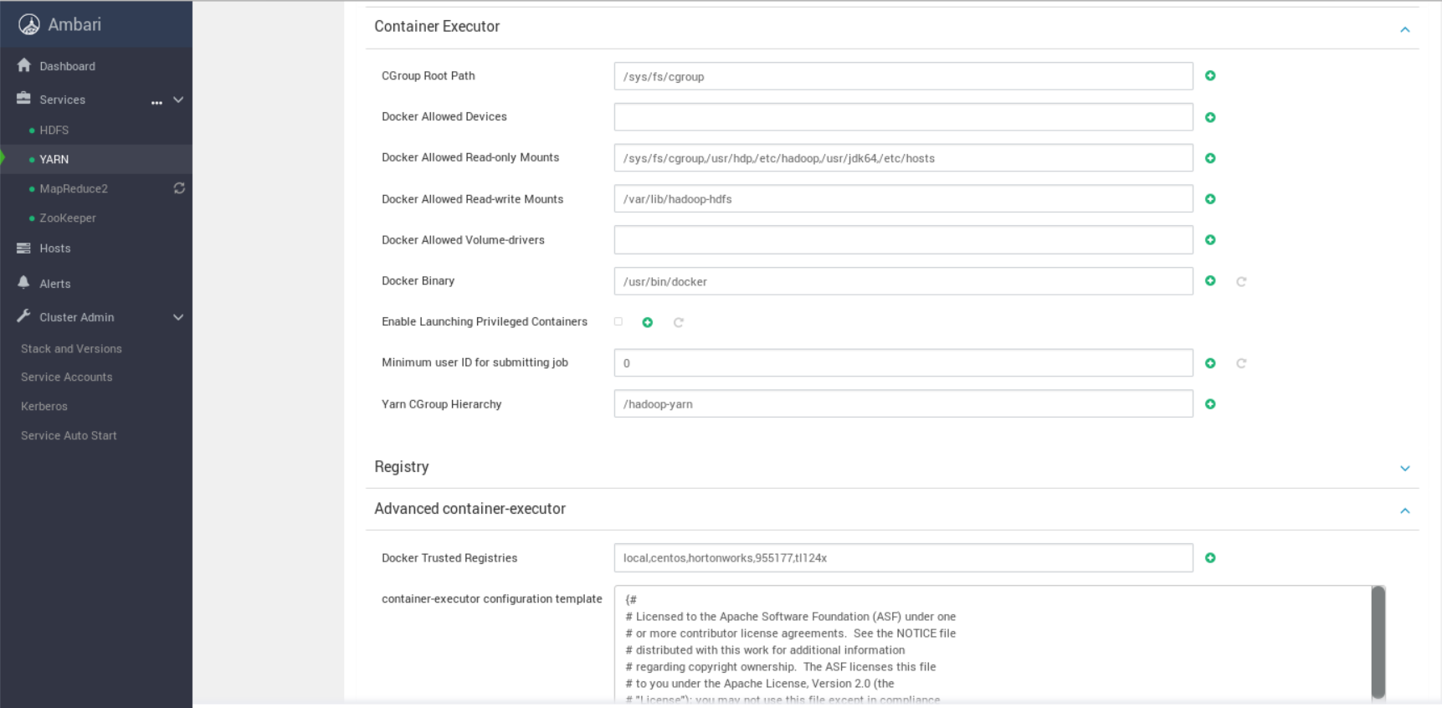
Real-time view of the cluster (Cont.)
This is where you setup your storage volume mount and Docker trusted registries.

Slide 14
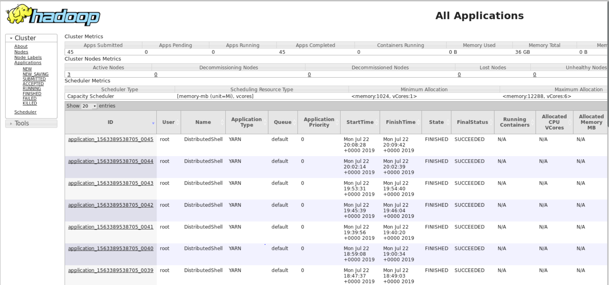
Resource Manager Web UI
Shows information about the application which is running, who is running the application and also the application type.

Slide 15
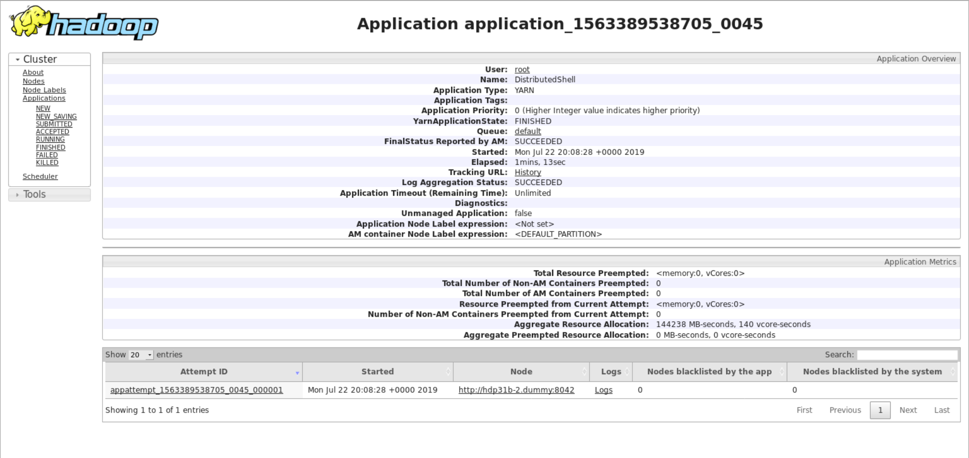
Resource Manager Web UI (cont.)
Click on any application to see the number of attempts taken to run, which host ran the application and the log files.

Slide 16
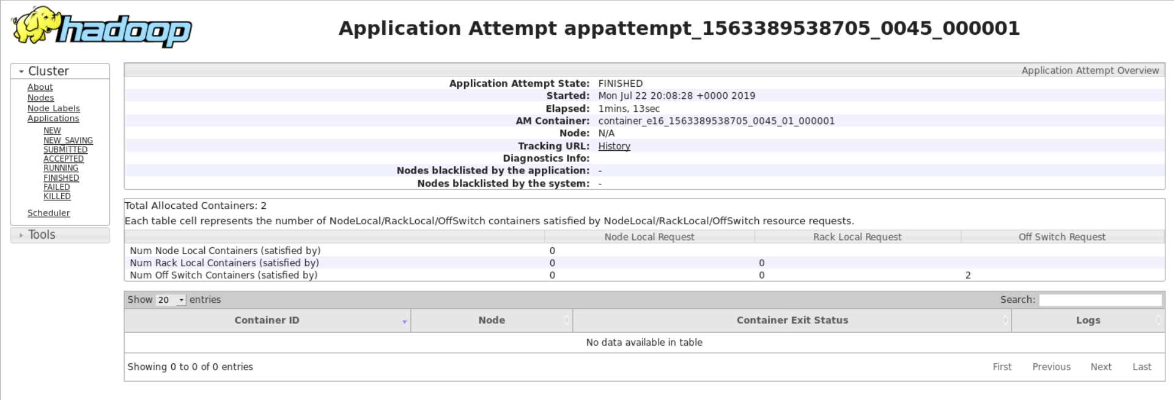
Application Web UI (cont.)
Click on attempts to see the total containers used to run the application and during runtime you can track your application live here.

Slide 17
Different Application Masters
Distributed Shell:
Volumes can be mounted and docker image can be specified during runtime.
RUNTIME_TYPE, NUMBER_OF_CONTAINERS can also be specified
YARN Application:
Looks in the form of a JSON file.
Needs a launch command to run the application.
Used for long-running applications.
MapReduce:
Follows Mapper & Reducer approach.
Mapper maps the data from different datanode and Reducer performs the operation specified.
Spark:
Application Master is a standalone application that YARN NodeManager runs in a YARN container to manage a Spark application running in a YARN cluster.
Sweater:
Sweater is a YARN application master that is built in house for running anything in Java, R, Python, Bash, etc.
Sweater has an API for monitoring and administration and also different containers can post their location and find out where other parts are.
You tell Sweater about the containers you want by writing a configuration file in JSON.

Slide 18
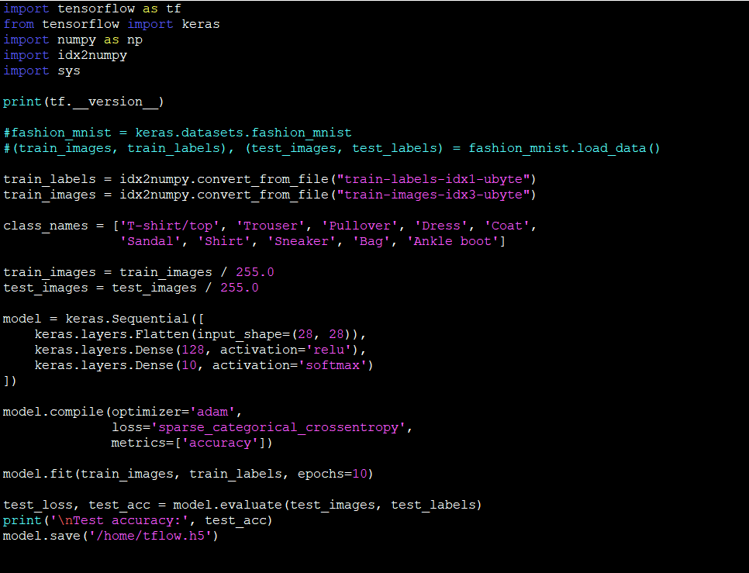
Real-time Training of ML application
Code to train the model using train data and save the trained model. We put this inside the “train” Docker container
as the file fashionMNIST.py.
Code is adapted from https://www.tensorflow.org/beta/tutorials/keras/basic_classification.

Slide 19
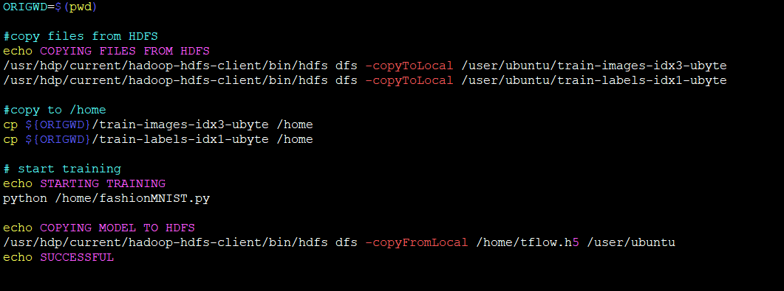
Real-time Training of ML application(cont.)
Shell file which helps us find the location of container and also executes the step-by-step process for training the model and storing it in HDFS. We put this inside the “train” Docker container as the file “train.sh”.

Slide 20
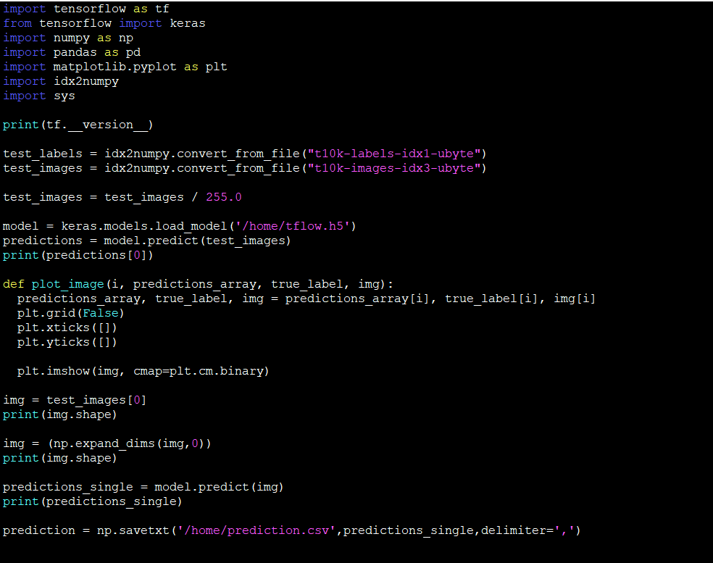
Real-time Prediction of ML application
Code to load the trained model, do prediction for test data and save the prediction output. We put this inside the
“prediction” Docker container as the file MNISTprediction.py.
Code is adapted from https://www.tensorflow.org/beta/tutorials/keras/basic_classification.

Slide 21
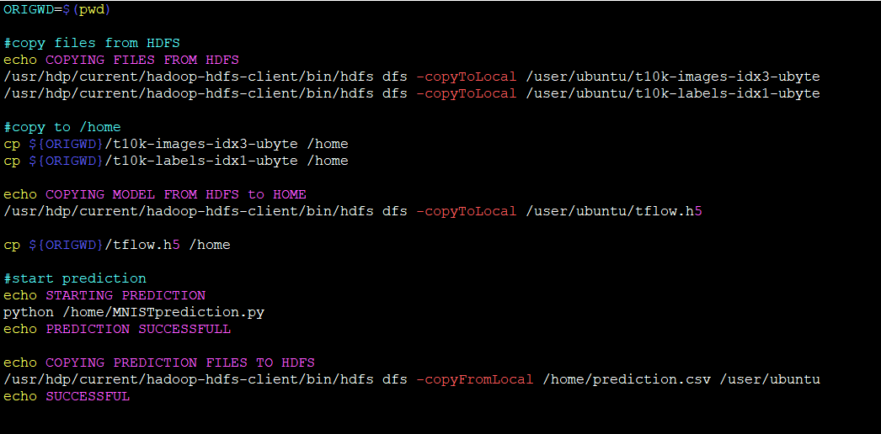
Real-time Prediction of ML application(cont.)
Shell file which helps us find the location of container and also executes the step-by-step process for serving the model and storing it in HDFS. We put this inside the “prediction” Docker container as the file “prediction.sh”.

Slide 22
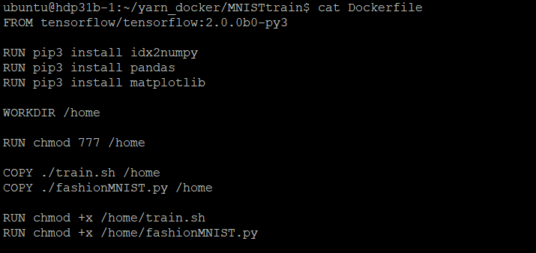
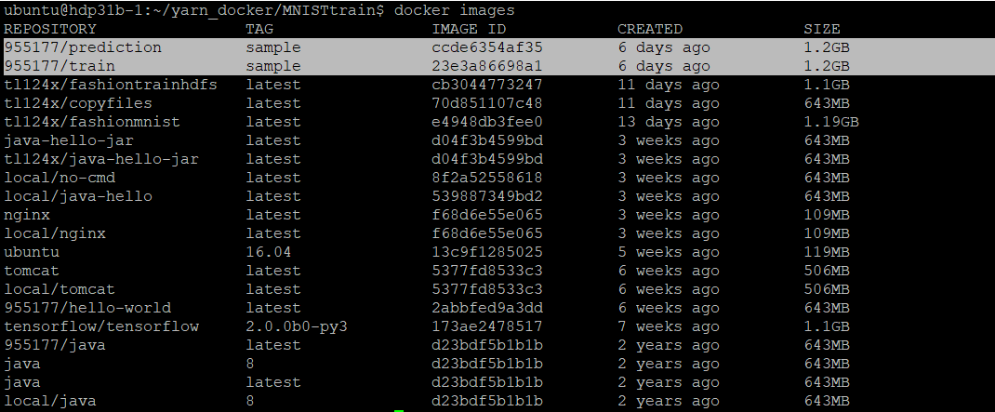
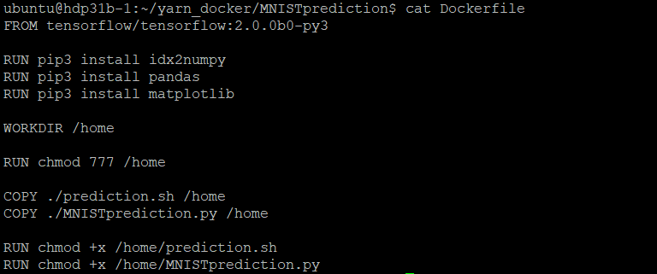
Creating Docker Images for Training and Prediction
Dockerfiles for “train” and “prediction” images.
“train” and “prediction” images in local Docker environment

Slide 23
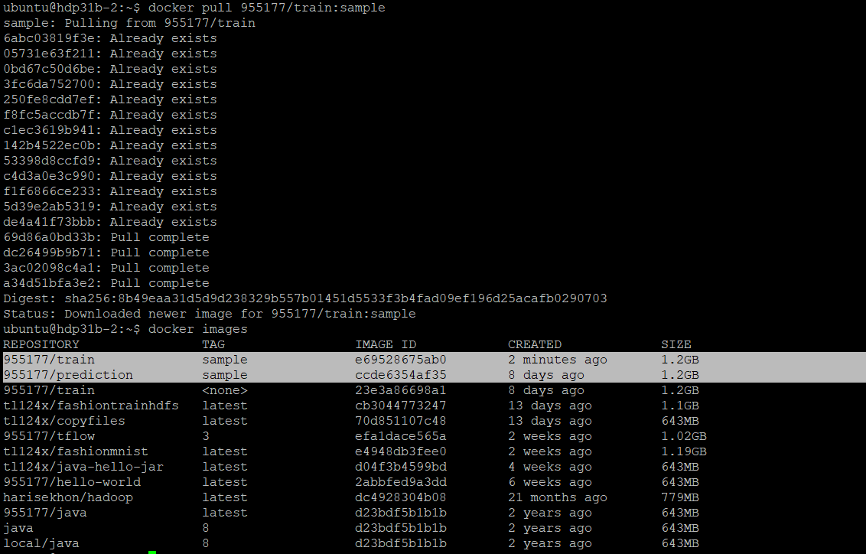
Pulling the docker image on all the host
Once the docker image is built using the Dockerfile we have to pull the image on all the hosts of the Hadoop cluster since the container could end up running on any of the hosts.
This is one of the major challenges that we are facing.

Slide 24
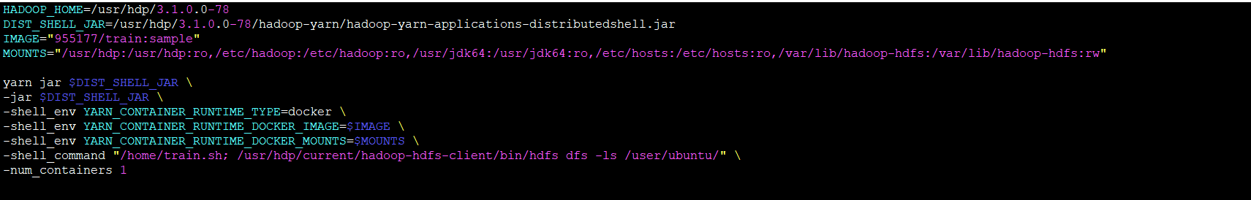
Running Training Image in a Distributed Shell App.
Shell program to run our Docker container using the Distributed Shell Application Master.
Using the Docker Image 955177/train which we built earlier we are doing training using a Distributed Shell App.
Need to specify the runtime type as “docker” and the path to the distributed shell application master jar file.
To read and write to HDFS we need to specify volumes with HDFS executables to be mounted during runtime.

Slide 25
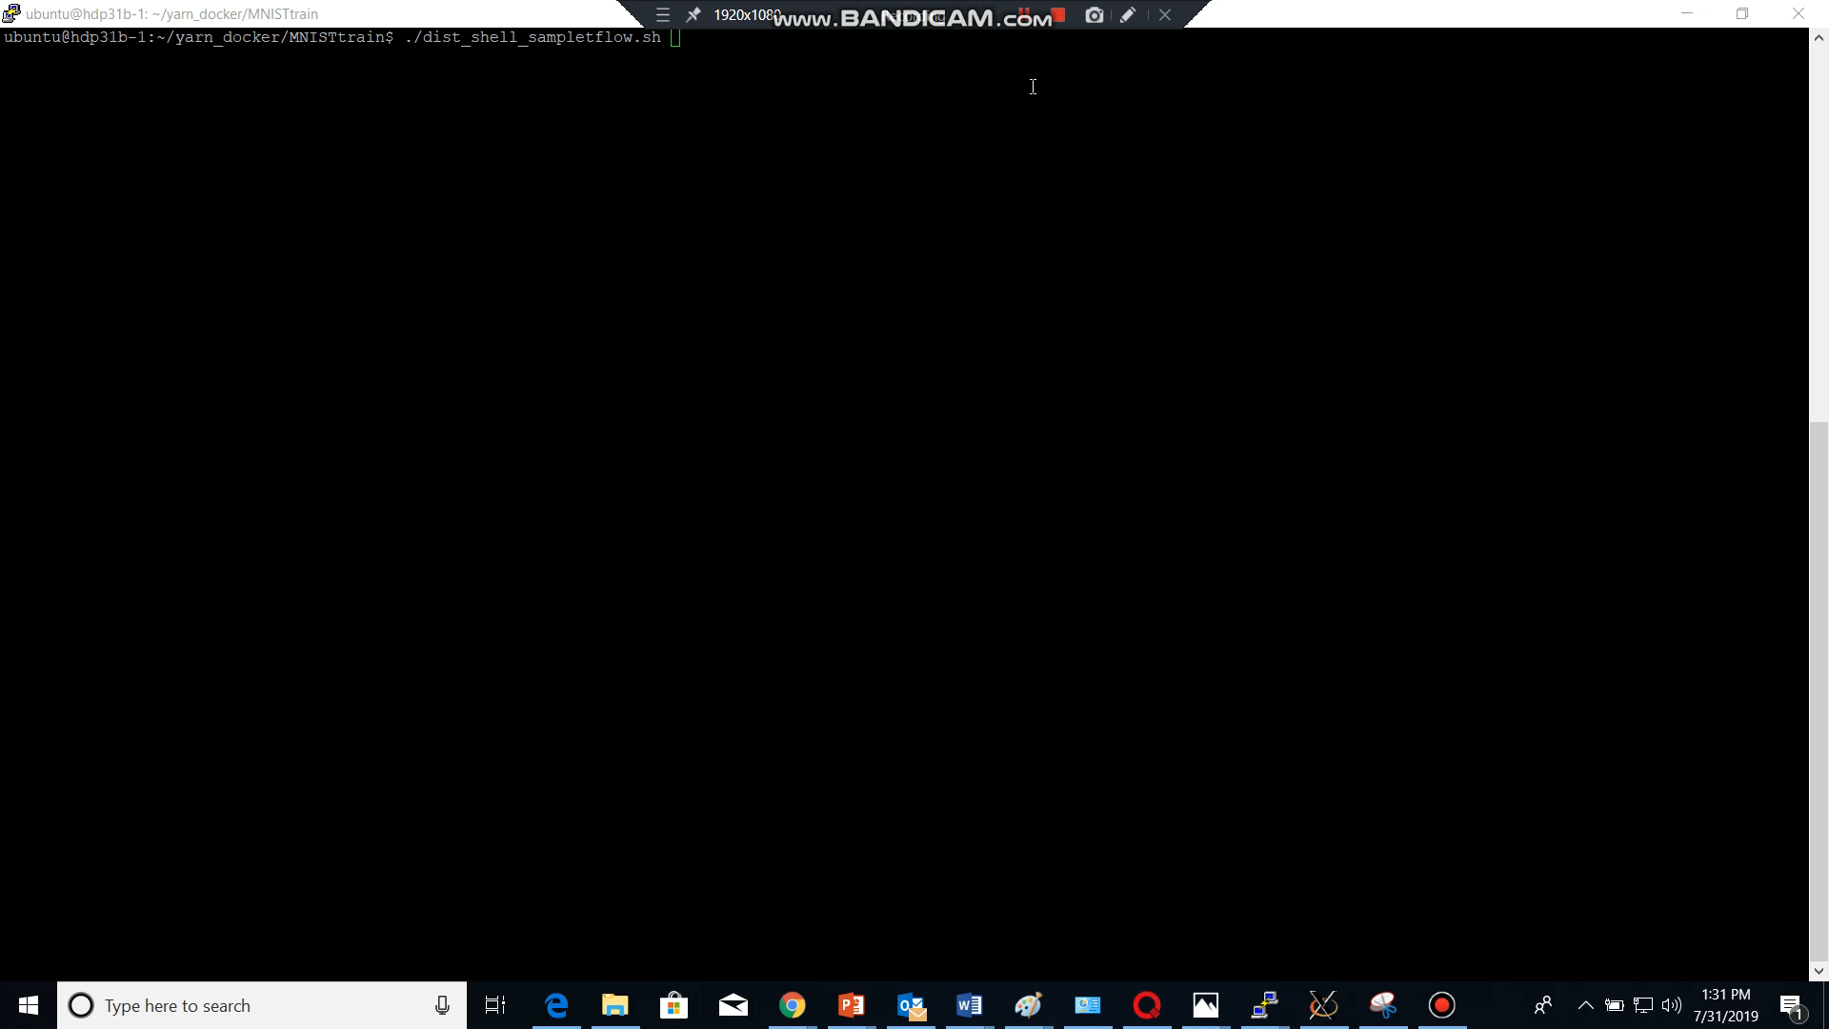
Running Training Image as a Distributed Shell App.(cont.)

Slide 26
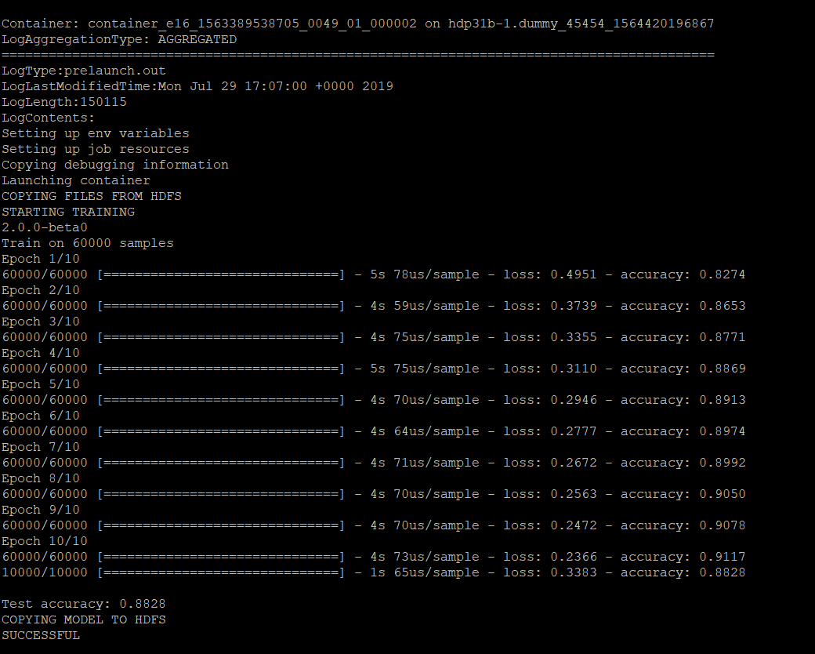
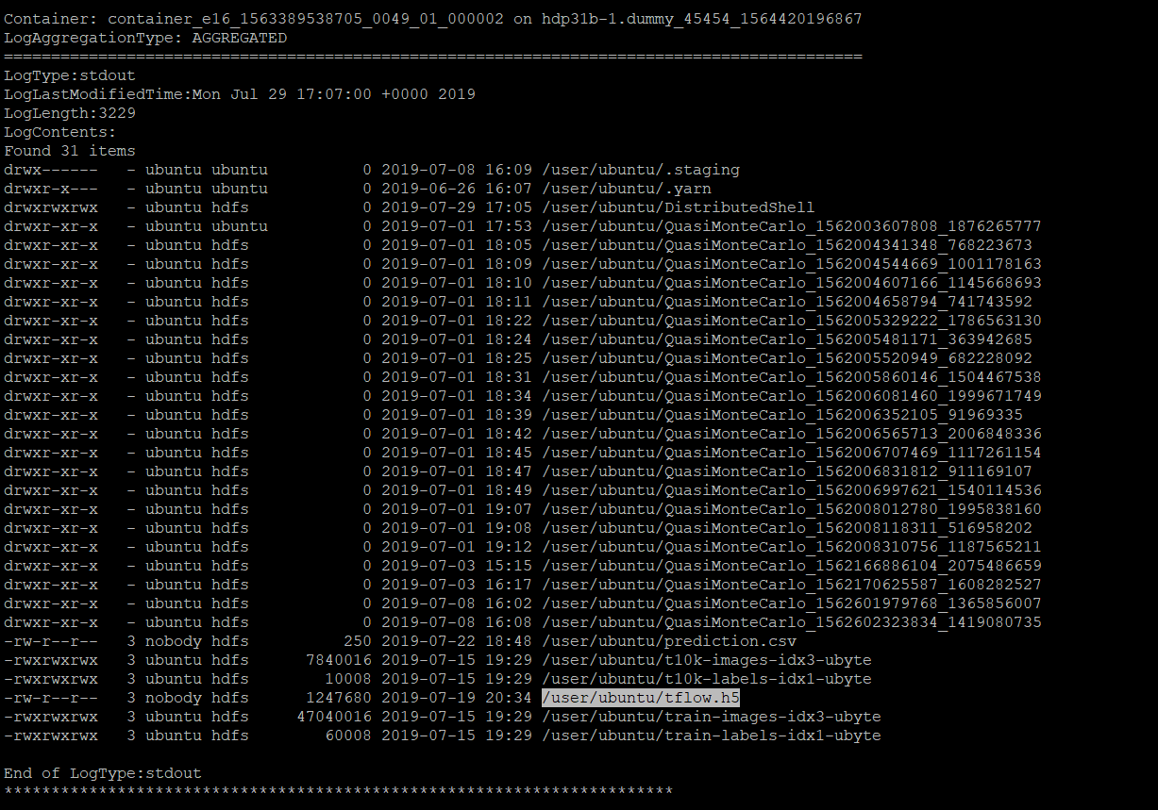
Running Training Image as a Distributed Shell App.(cont.)
OUTPUT-1 (train.sh)
OUTPUT-2 (hdfs dfs –ls )

Slide 27
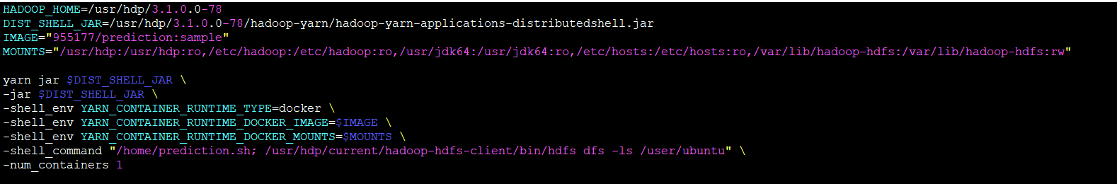
Running Prediction Image in a Distributed Shell App.
Using the docker Image 955177/prediction which we built earlier we are doing serving to predict the output using a Distributed Shell App.
To read and write to HDFS we need to specify volumes with HDFS executables to be mounted during runtime.

Slide 28
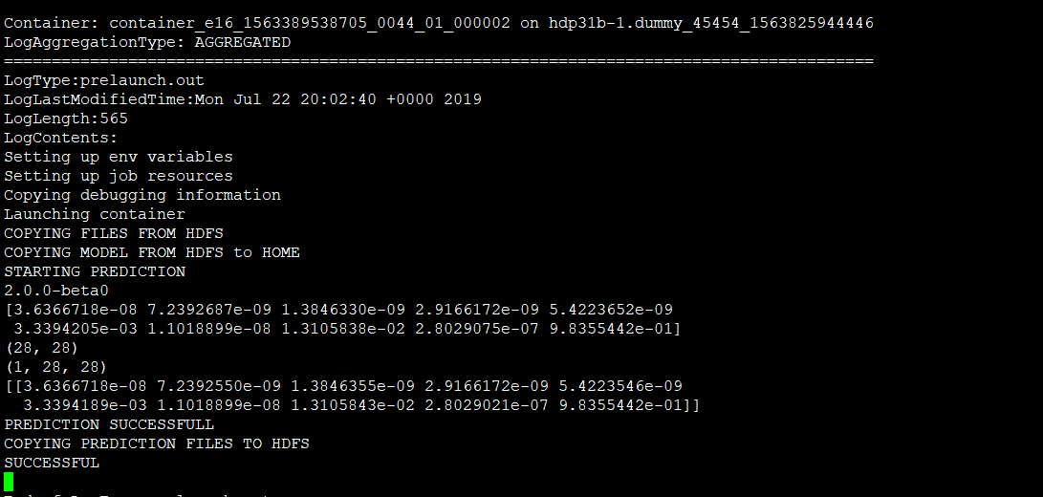
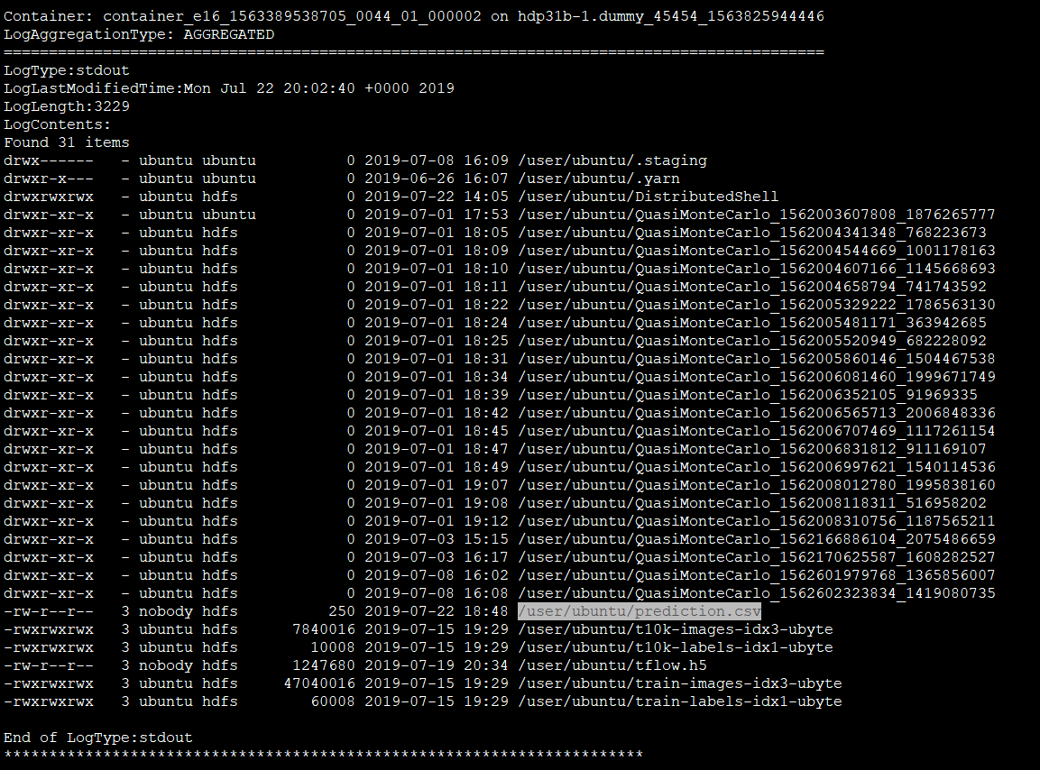
Real-time Prediction of ML application(cont.)
OUTPUT-1 (prediction.sh)
OUTPUT-2 (hdfs dfs –ls)

Slide 29
Challenges
Read/Write data from/to respectively from HDFS into the Docker container.
Automate the pulling of Docker images from the repository.
Kerberizing the cluster and provide comprehensive security.
Configuring Docker networking to support distributed processing & pipelining.
Building a custom Application Master (extend Sweater) that can start multiple containers simultaneously.
Future Works
In future this could pave way for ACUMOS to deploy dockerized Machine Learning model into fully configured Hadoop cluster.

Slide 30
THANK YOU. QUESTIONS?

Slide 31
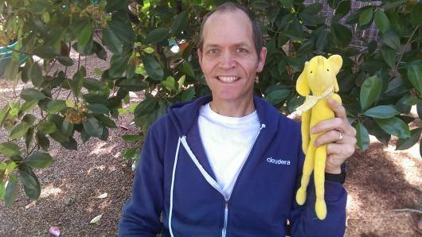
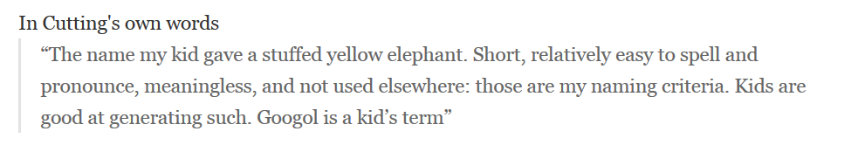
Doug Cutting with Hadoop The Elephant

Slide 32
Why HADOOP?
Why not just install Docker on all the host machines and run applications?
Docker builds the entire application as a package and it also improves the performance and reduces the size of the application.
Docker lacks an effective scheduler which can allocate resources to the containers during runtime.
Hadoop has a single scheduler unlike Kubernetes where each pod has its own scheduler.
Hadoop scheduler can provide excellent resource management and provides features like Capacity queuing.
Capacity resource sharing system is designed to provide guaranteed resource availability depending on enterprise priority

Slide 33
Kubernetes vs Apache YARN
Kubernetes | Apache YARN
Security is default to open. Primary group of pods are default to root. This can be problematic when trying to secure the infrastructure | Kerberos provides high security to the cluster. Also setting features like privileged/non-privileged containers, trusted docker images/repositories provides security.
Solely developed for extending docker container kernel to become a platform. | Distributed SQL engines like Hive are built on top of YARN and MR, Hive, Pig have their own style of deployment.
Excellent optimization when specifying resources to containers/pods. | Important information stored in database can be run in containers or batch mode.(Eg: Online transaction processing)
Lacks global scheduler and runs multiple scheduler which manages resources within its own pods. | Single scheduler which assign resources equally to all the nodes and provides excellent resource management
.

Slide 34
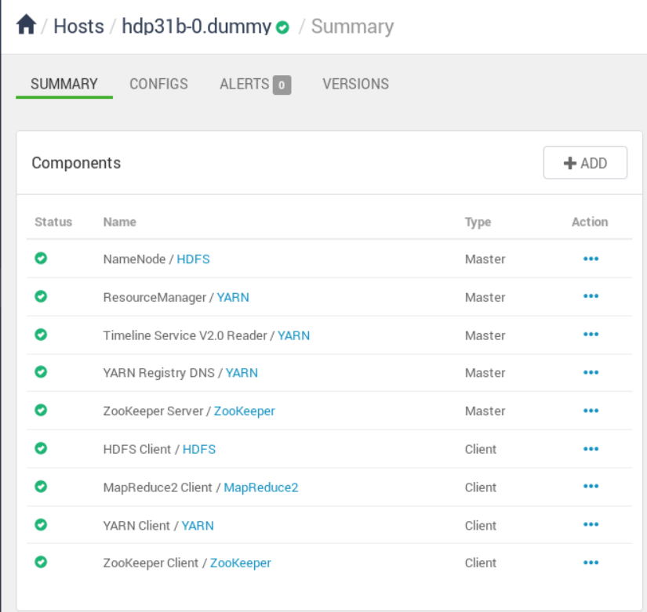
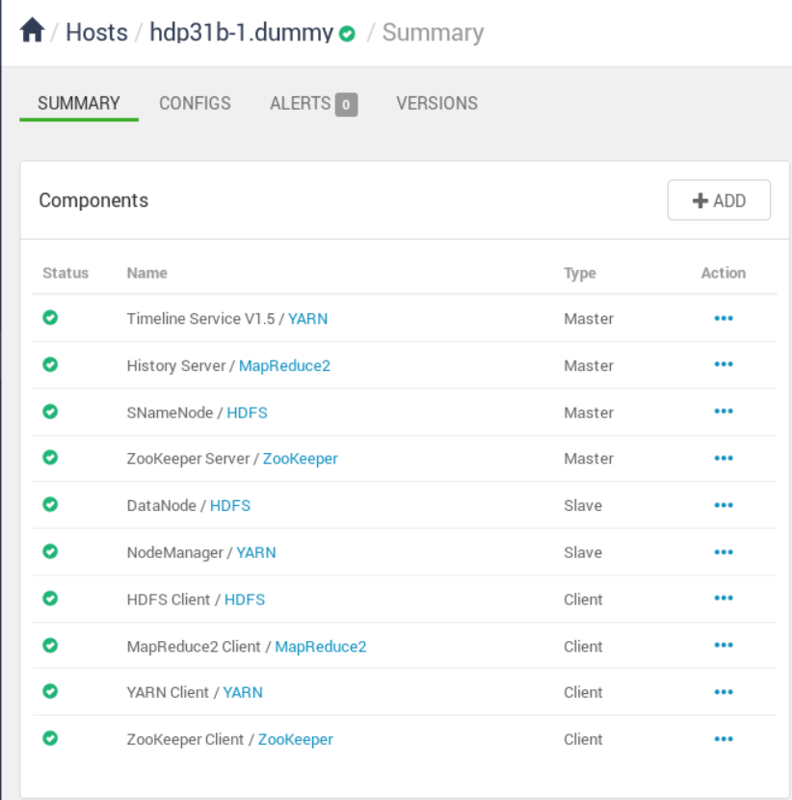
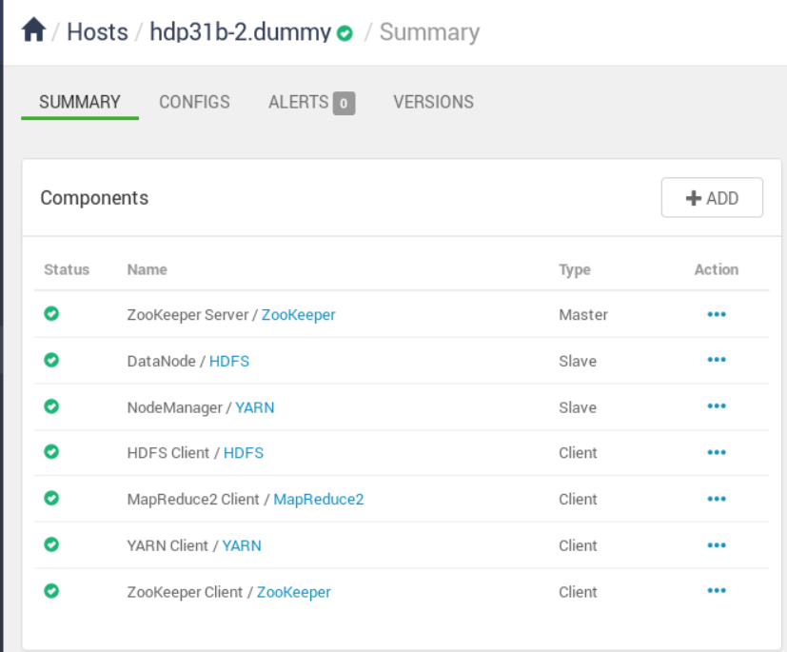
Real-time view of the cluster (Cont.)

